Slide 1
GRANADE
Andre Olaisen

Slide 2
Gradient seeking agent
Making an agent that tries to find and explore large salinity gradients in the field.
These regions are regions are interesting from a biological point of view.
Want the agent to move across the river plume and measure the gradient

Slide 3
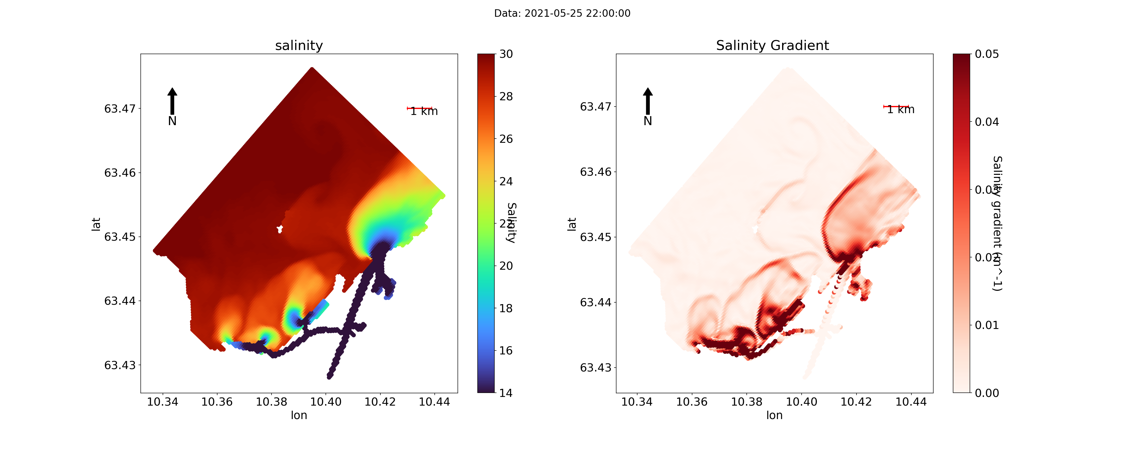
Sinmod simulation

Slide 4
Sinmod simulation
Plume front (high gradient region)
Munkholmen
River outlets

Slide 5
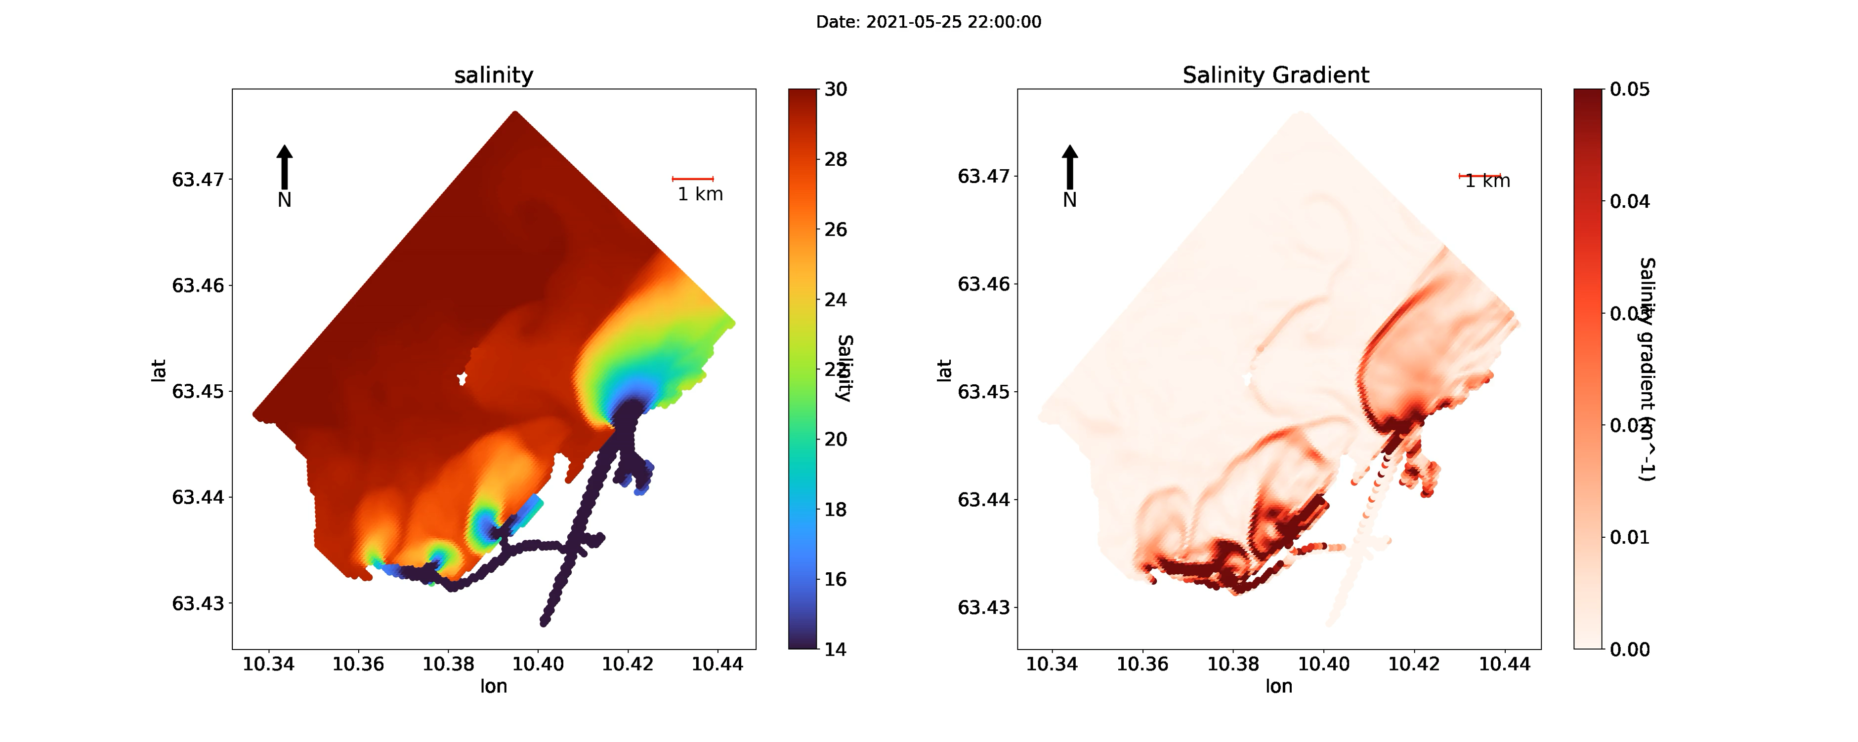
Sinmod simulation

Slide 6
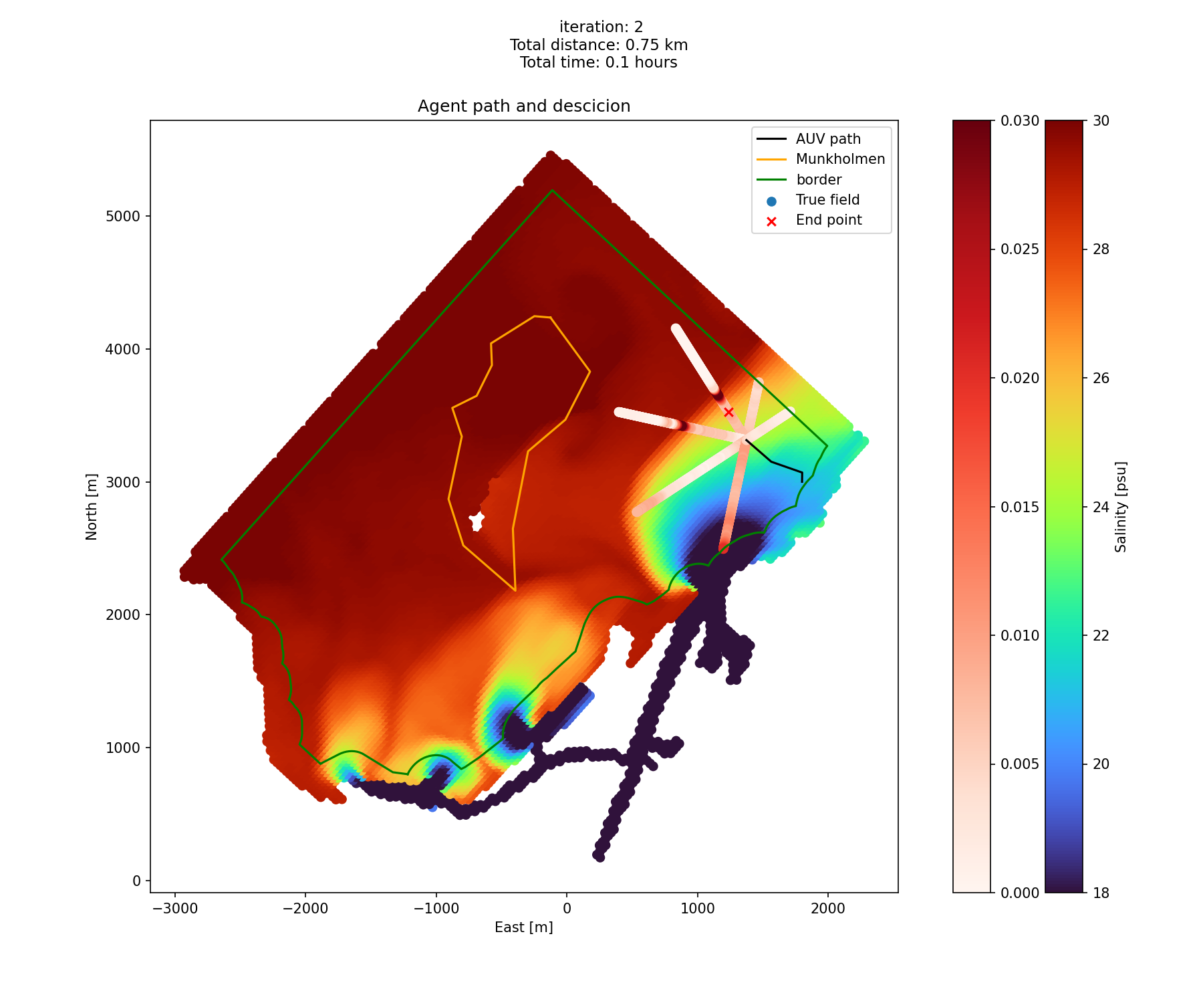

Slide 7
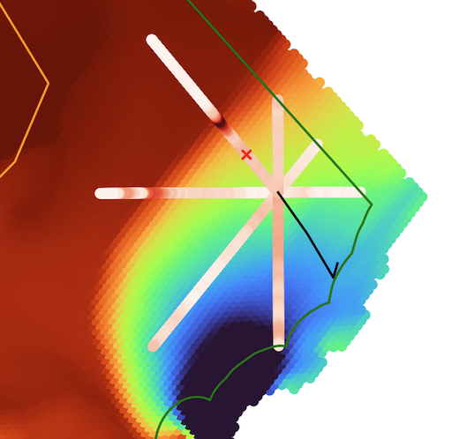
Possible paths
Previous path

Slide 8
Horizon How far the agent can predict
Radius How far the agent will move each step

Slide 9
Will move to this point
Predicted high gradient

Slide 10
Will move to this point
Possible paths
Predicted high gradient
Previous path
Horizon How far the agent can predict
Radius How far the agent will move each step

Slide 12


Slide 13


Slide 14


Slide 15
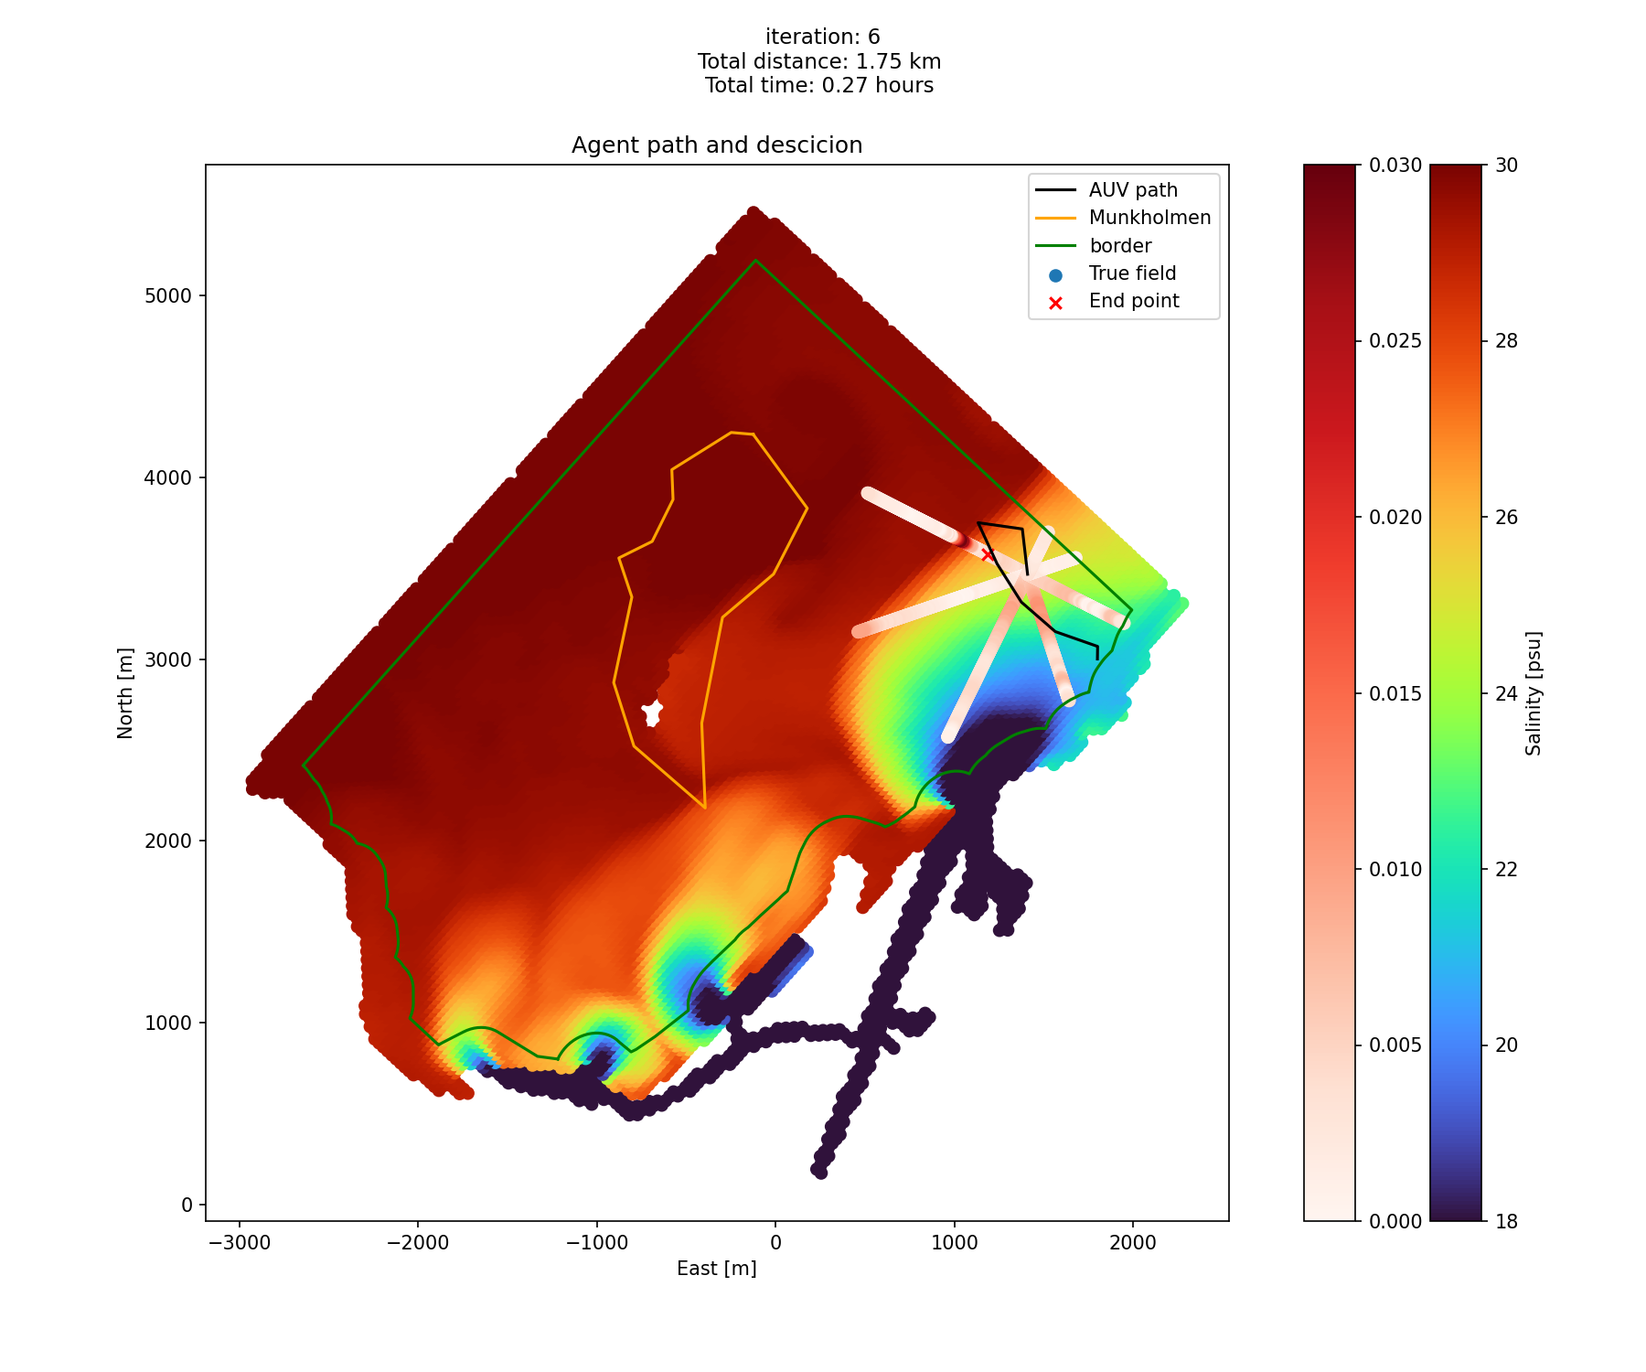

Slide 16


Slide 17
General idea
The main idea is to try and find a gradient that is higher than the agent has measured before.
This means that we want to run transacts where we predict the gradient will be higher, and often where there is some uncertainty.

Slide 18
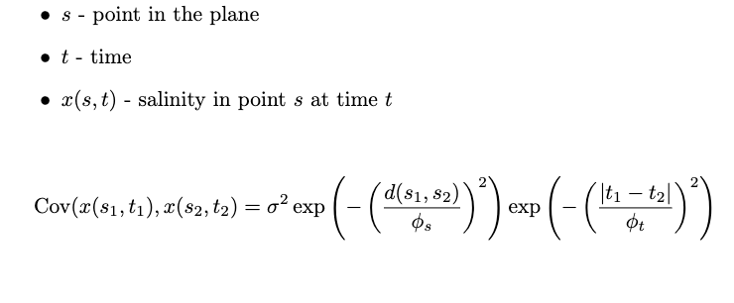
Statistical model

Slide 19
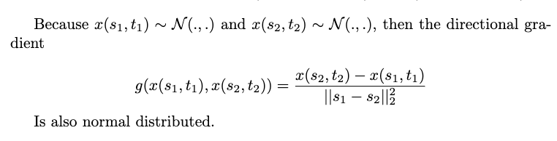

Slide 20
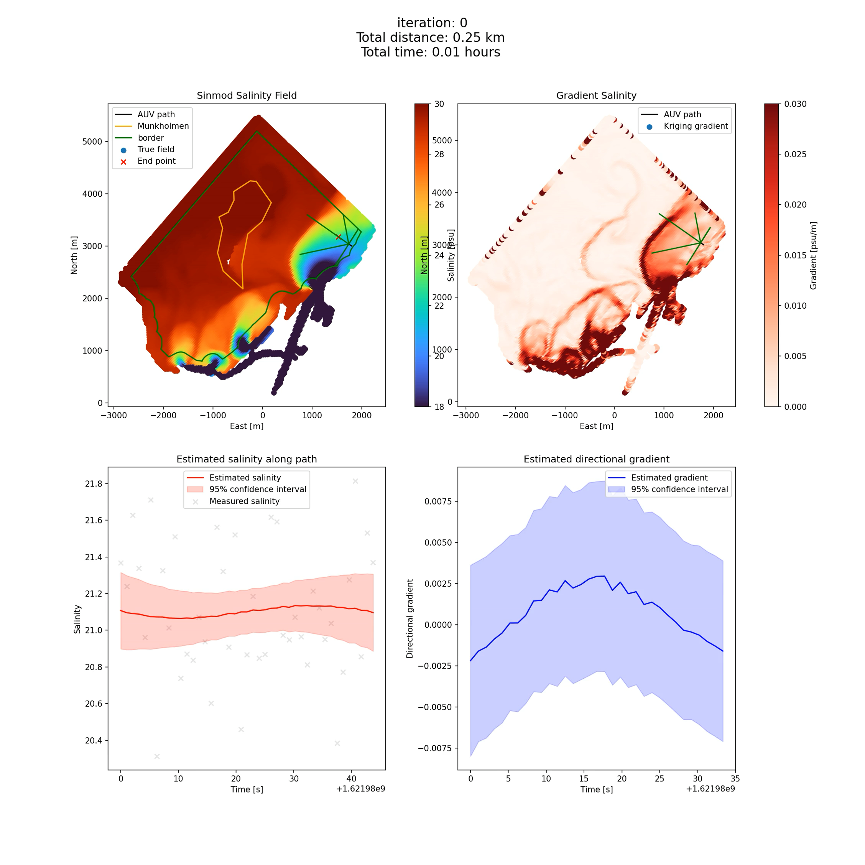

Slide 21
Mascot Nidelva field test June 2023
Date: June 19 - June 23.
We will run both MAFIA and GRANADE during this test
Karoline Barstein will be responsible for operating the AUVs

Slide 22
